Slide 1
BIOE 498 / BIOE 599: Computational Systems Biology for Medical Applications CSE 599V: Advancing Biomedical Models Lecture 2: Modeling Essentials
Joseph L. Hellerstein*
Herbert Sauro**
*eScience Institute, Computer Science & Engineering
**BioEngineering

Slide 2
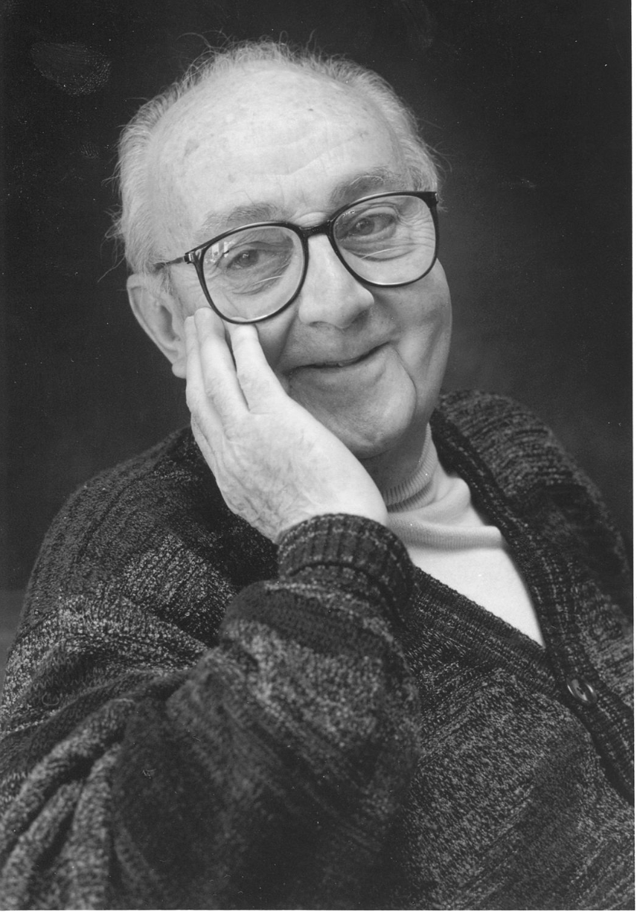
G.P.E. Box (Famous Statistician)
All models are wrong.
But some models are useful.

Slide 3
Agenda
Conceptual models (hydraulics example)
Variables and relationships
Dimensional analysis
Modeling the lac operon
Technical models with differentials
Technical models with stochastics

Slide 4
Refresher
What are we modeling?

Slide 5
Running Example: Hydraulic Engineering
Streams fill lake
Flow rate
Lake provides recreation
Water level
Flow rate
Streams fill reservoir
Flow rate
Pipe provides lake water to reservoir
Flow rate
Reservoir provides public water
Water level
Flow rate

Slide 6
The Problem
_{Lake height}
_{Reservoir height}
Maximize the height of the lake water subject to a minimum height of the reservoir water.
Most recreational benefit to public
Ensure delivery of quality water to public

Slide 7
The Problem
_{Lake height}
_{Reservoir height}
Maximize the height of the lake water subject to a minimum height of the reservoir water.
Most recreational benefit to public
Ensure delivery of quality water to public

Slide 8
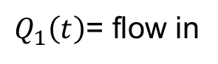
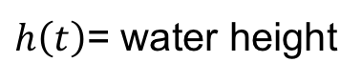
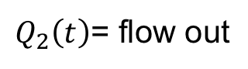
Towards a Conceptual Model: Identify Variables
$Q_{1}\left(t\right)$= flow in
(m³s⁻¹)
$h\left(t\right)$= water height
(m)
$Q_{2}\left(t\right)$= flow out
(m³s⁻¹)
Notes:
What happens if height is too high? Limit of model?

Slide 9
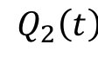
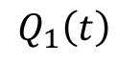
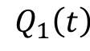
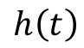
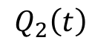
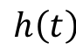
A conceptual model relates inputs to outputs.
$$Q_{1}\left(t\right)$$
$$h\left(t\right)$$
$$Q_{2}\left(t\right)$$
$$Q_{1}\left(t\right)$$
Variable Roles
Input. Exogenous variable that does not depend on the model.
Output. Computed variable of interest to the modeler.
State: Computed variable used by output variables and other state variables.
Calculations
$$h\left(t\right)$$
$$Q_{2}\left(t\right)$$

Slide 10
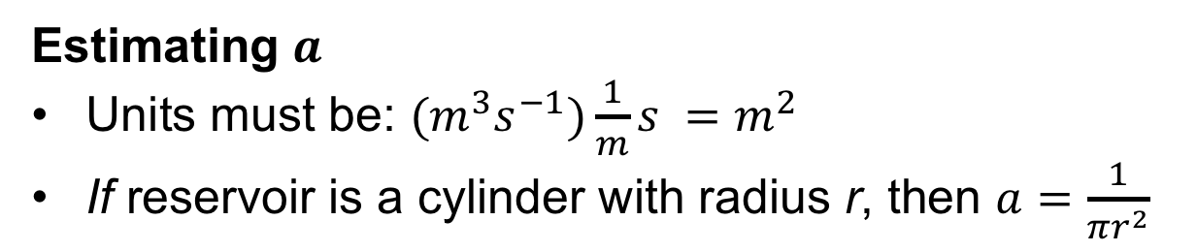
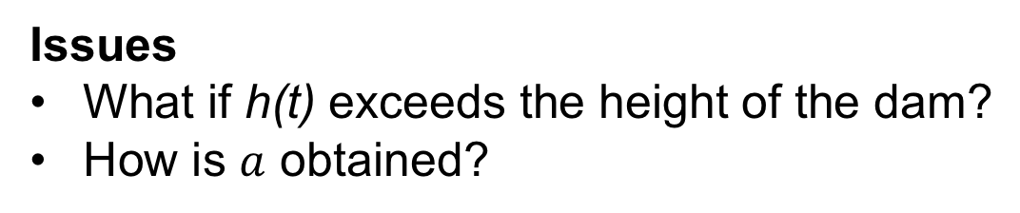
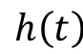
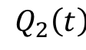
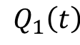
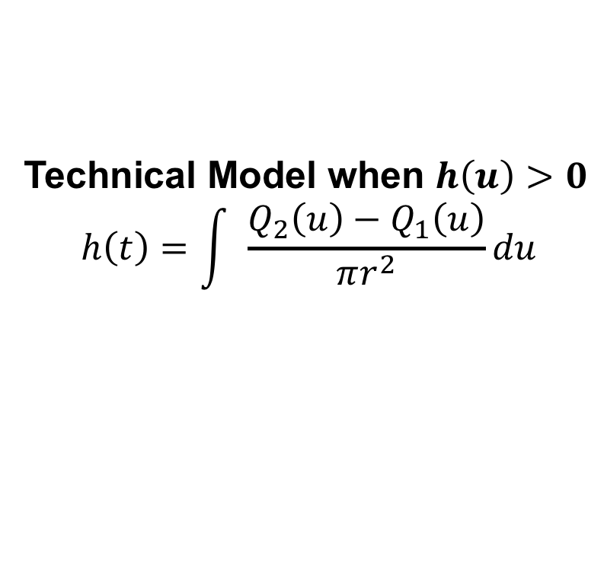
Technical models detail calculations.
$$Q_{1}\left(t\right)$$
Initial Technical Model
$$h\left(t\right)$$
$$dh\left(t\right)={a(Q}_{2}(t)−Q_{1}(t))dt, h\left(t\right)>0$$
$$Q_{2}\left(t\right)$$
Issues
What if h(t) exceeds the height of the dam?
How is $a$ obtained?
Estimating $a$
Units must be: ${(m}^{3}s^{−1})\frac{1}{m}s =m^{2}$
If reservoir is a cylinder with radius r, then $a=\frac{1}{πr^{2}}$
Technical Model when $h\left(u\right)>0$
$$h\left(t\right)=\int{\frac{{Q_{2}\left(u\right)−Q}_{1}\left(u\right)}{πr^{2}}du}$$

Slide 11
The reservoir is a cylinder?
The model is wrong.
But the model may be useful.

Slide 12
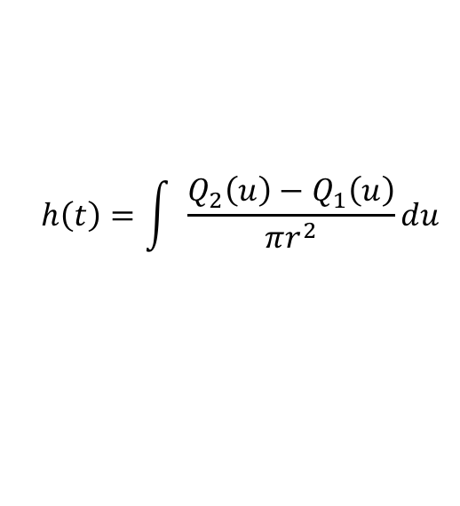
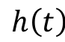
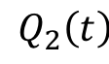
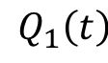
Modeling Workflow
System Diagram
Conceptual
Model
$$Q_{1}\left(t\right)$$
$$h\left(t\right)$$
$$Q_{2}\left(t\right)$$
V2.out
Technical
Model
$$h\left(t\right)=\int{\frac{{Q_{2}\left(u\right)−Q}_{1}\left(u\right)}{πr^{2}}du}$$

Slide 13
Vessel, Flow -> Species, Reactions
Relate to reactions
Show units
Conceptual model relates to metabolism
But box is for enzyme, not function

Slide 14
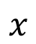
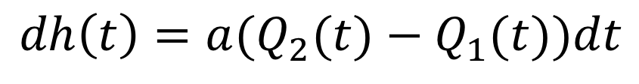
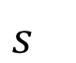
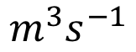
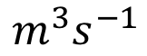
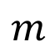
Dimensional Analysis
Why dimensional analysis?
Ensure consistent units.
Validate mathematical models.
Derive mathematical models.
$$dh\left(t\right)={a(Q}_{2}(t)−Q_{1}(t))dt$$
}
}
}
}
}
$$m$$
$$x$$
$$m^{3}s^{−1}$$
$$m^{3}s^{−1}$$
$$s^{}$$

Slide 15
Rules for Dimensional Analysis
Multiplying (dividing) units creates a compound unit.
Adding (subtracting) the same units gives the same units. Adding different units is undefined.
The units must be the same on both sides of an equals sign.
The arguments of transcendental functions (e.g., natural log) must be unitless.

Slide 16
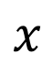
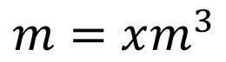
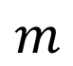
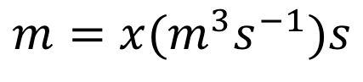

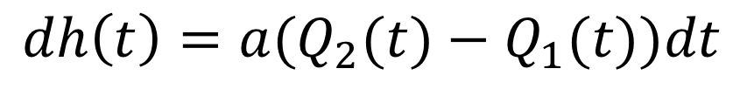
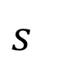
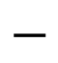
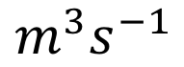

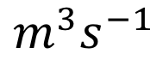
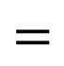
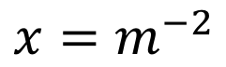
Solving for the units.
$$dh\left(t\right)={a(Q}_{2}(t)−Q_{1}(t))dt$$
}
}
}
}
}
$$m$$
$$=$$
$$x$$
$$($$
$$m^{3}s^{−1}$$
$$−$$
$$m^{3}s^{−1}$$
$$s^{}$$
$$)$$
By Rule 2:
Rules
Multiplying (dividing) units creates a compound unit.
Adding (subtracting) the same units gives the same units. Adding different units is undefined.
The units must be the same on both sides of an equals sign.
The arguments of transcendental functions (e.g., natural log) must be unitless.
$$m=x(m^{3}s^{−1})s$$
By multiplication:
$$m=xm^{3}$$
By Rule 3 & division:
$$x=m^{−2}$$

Slide 17
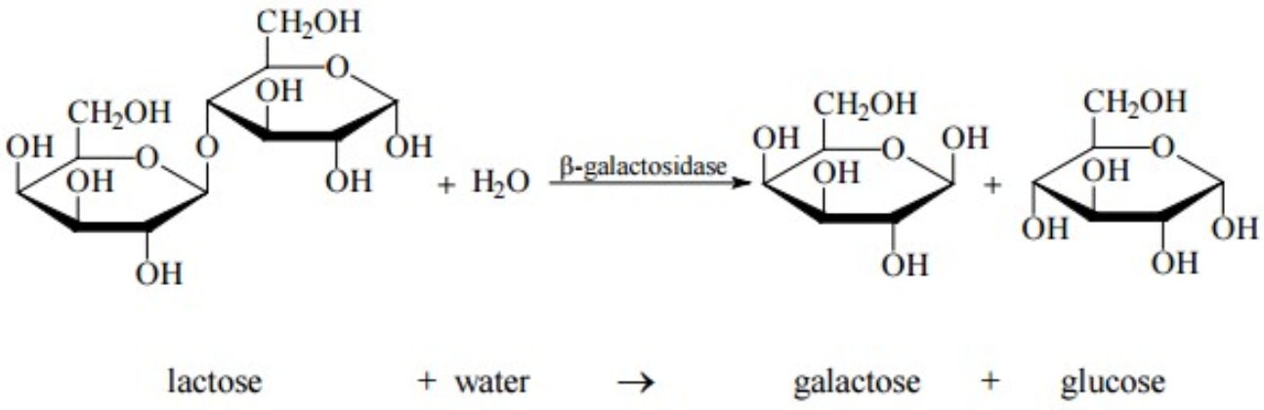
A Yeast Adaptation
Problem: yeast prefers glucose but sometimes only has access to lactose.

Slide 18
When Should Yeast Adapt?
Glucose | Lactose | lac Operon Transcription
+ | - | No adaptation
+ | + | Low adaptation
- | - | No adaptation
- | + | Strong adaptation

Slide 19
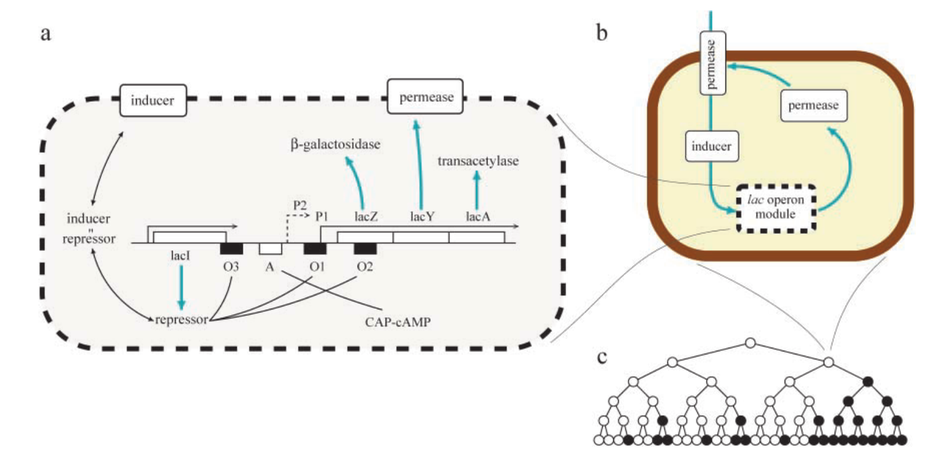
How Yeast Adapts: lac operation
Adaptations
Allow lactose into the cell
Convert lactose to galactose and glucose
*Vilar et al., 2003. Journal of Cell Biology.

Slide 20
Modeling the lac Operon
I_{ext}
System Diagram
P
I_{int}
I_{ext} = external inducer (lactose)
I_{int} = internal inducer
P = permease
*Vilar et al., 2003. Journal of Cell Biology.
What are the units of I_{ext}?
Concentration: count (molecules) divided by volume
Count in moles (M)
Volume in liters (l)
Ml⁻¹

Slide 21
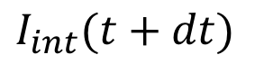
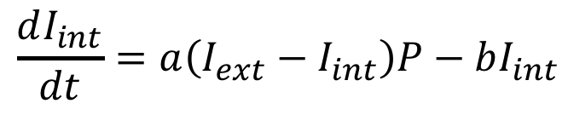
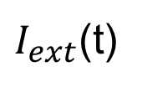
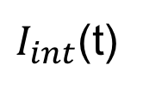
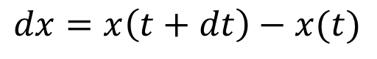
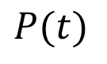
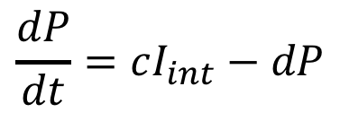
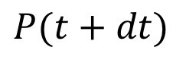
Modeling the lac Operon
I_{ext}
System Diagram
P
Simplified System Diagram
I_{int}
Conceptual Model
Technical Model
$I_{ext}$(t)
$I_{int}$(t)
$$P(t)$$
$$dx=x\left(t+dt\right)−x(t)$$
*Vilar et al., 2003. Journal of Cell Biology.
1:
$$\frac{dI_{int}}{dt}=a\left(I_{ext}−I_{int}\right)P−bI_{int}$$
1
2
$$\frac{dP}{dt}=cI_{int}−dP$$
$$I_{int}(t+dt)$$
$$P(t+dt)$$
2:
Questions
What are the units of dP/dt?
What are the units of c?
What are the units of a?
Ml⁻¹s⁻¹
s⁻¹
M⁻¹ls⁻¹

Slide 22
Technical Models With Differentials

Slide 23
Technical Models With Stochastics

Slide 24
Learning Objectives
Conceptual models
Construct appropriate element abstractions of a system, their variables, and the relationships between variables

Slide 25
BACKUP

Slide 26
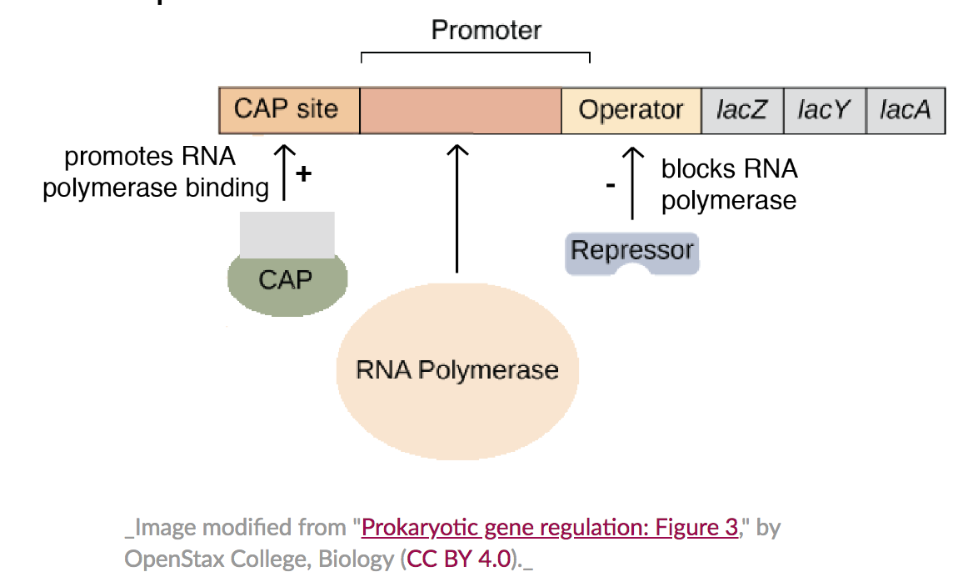
Gene Layout lac Operon

Slide 27
Variable Roles
The role of a variable is how it is used in a model.
A variable may have different roles in different models.
Flow out
Q^{OT}(t) = Q* if h(t) > 0
Q^{OT} (t) = min(Q*, Q^{IN} (t)), otherwise
Height
dh(t) = Q^{IN} – Q^{OT}, h(t) > 0
dh(t) = Q^{IN} – Q^{OT}, if positive
dh(t) = 0, otherwise
Model 1: Find Q^{OT}(t_{f}) given Q^{IN} and initial value of h.
Input: Q^{IN}(0), …, Q^{IN}(t_{t}) and h(0).
Output: Q^{OT}(t_{f})
Model 2: Find h(t_{f}) given Q^{IN} and initial value of h.
Input: Q^{IN}(0), …, Q^{IN}(t_{t}) and h(0).
Output: h(t_{f})

Slide 28
Conceptual Model
F1
V1
F2
A conceptual model specifies how the inputs of one element relate to the outputs of other elements.
C
V2
F1.out
=
+
F2.out
=
C.in
C.setting
V2.in
V1.in
V2.height
V1.height
C.out
V2.out
V1.out
Modeling objective
Given F1.out, F2.out
Find V1.height, V2.height

Slide 29
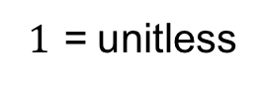
Element
Abstraction of a system component.
Has one or more variables.
Variables
Units
rivers
Flow:
Q^{OT} = flow out
m³s⁻¹ = cubic meters per sec
lake
dam
Q^{IN} = flow in
m³s⁻¹
Container:
Q^{OT}= flow out
m³s⁻¹
pipe
h = water height
m = meters
Control:
Q^{IN} = flow in
m³s⁻¹
Q^{OT}= flow out
m³s⁻¹
v = valve setting
$1$ = unitless

Slide 30
A conceptual model relates inputs to outputs.
Variables
Conceptual
Model
Flow:
out
in
Vessel:
out
unknown
function
height
Conduit:
in
unknown
function
out
setting

Slide 31
Modeling Workflow
System Diagram
Conceptual
Model
F1.out
=
+
F2.out
=
P.in
P.setting
V2.in
V1.in
V2.height
V1.height
P.out
V2.out
V1.out
Technical
Model
dVessel.height = (Vessel.out – Vessel.in)/(Pi*Vessel.radius²)

Slide 32
Technical Model for Vessel.height
Vessel.volume = Vessel.height*Pi*Vessel.radius²
dVessel.Volume = Vessel.out – Vessel.in
dVessel.height = (Vessel.out – Vessel.in)/(Pi*Vessel.radius²)
Integrate (sum) to calculate Vessel.height from dVessel.height.

Slide 33
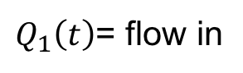


Abstraction of A System Component
Variables
Units
$Q_{1}\left(t\right)$= flow in
m³s⁻¹
$Q_{2}\left(t\right)$= flow out
m³s⁻¹
$h\left(t\right)$= water height
m = meters
Operation
Flow out
Q^{OT}(t) = Q* if h(t) > 0
Q^{OT} (t) = min(Q*, Q^{IN} (t)), otherwise
Height
dh(t) = Q^{IN} – Q^{OT}, h(t) > 0
dh(t) = Q^{IN} – Q^{OT}, if positive
dh(t) = 0, otherwise
Notes:
What happens if height is too high? Limit of model?

